Slide 1
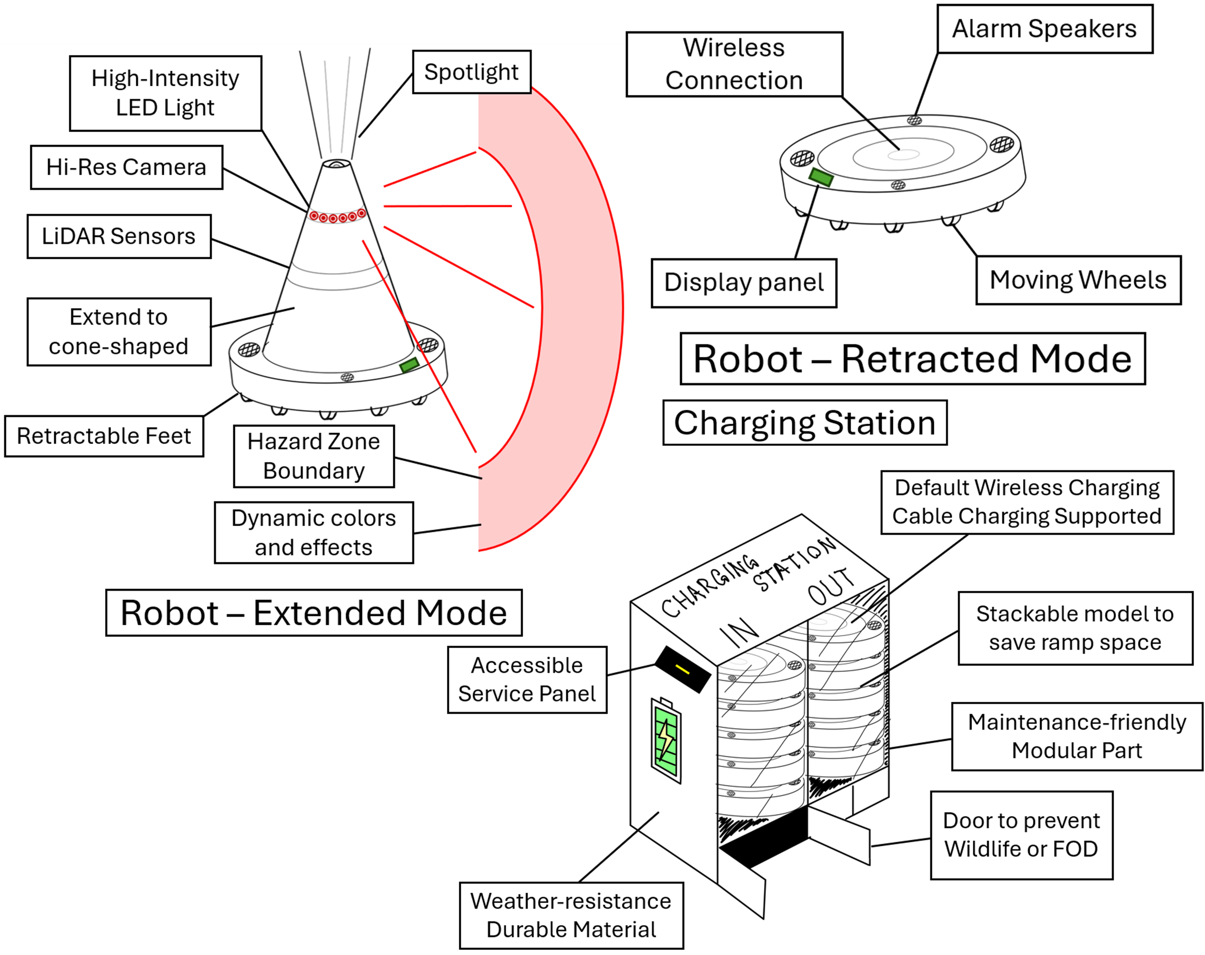
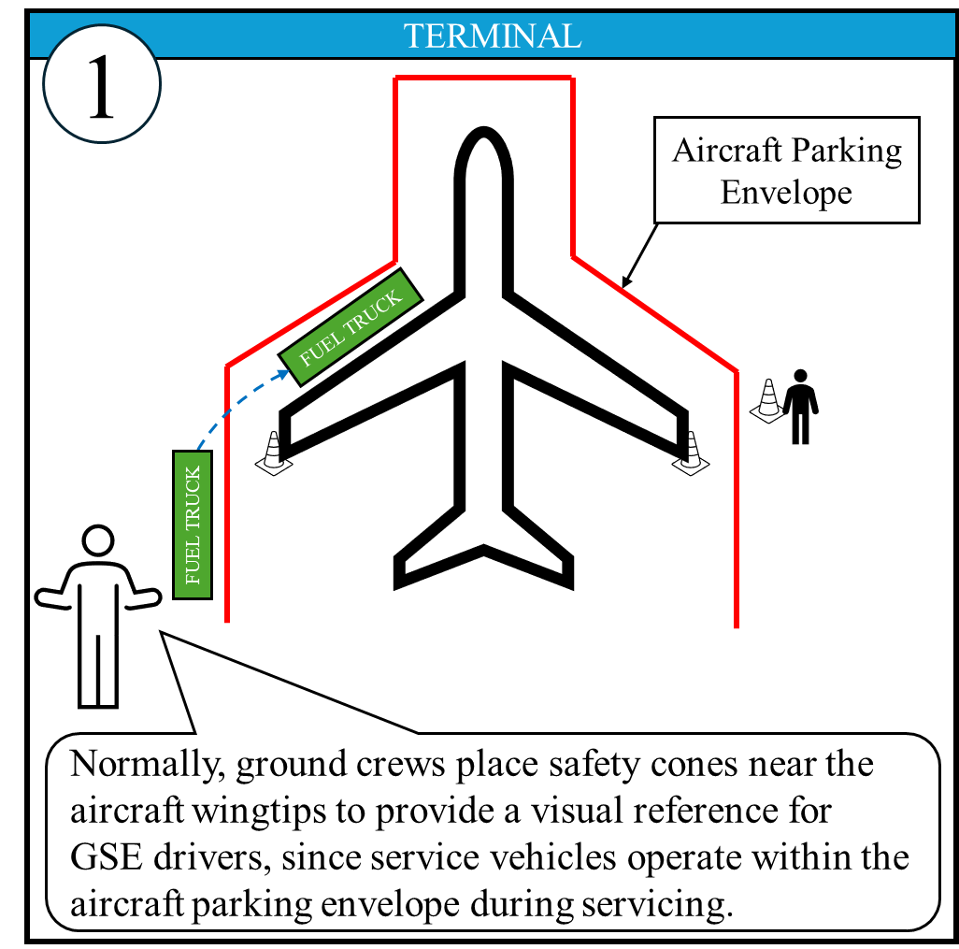
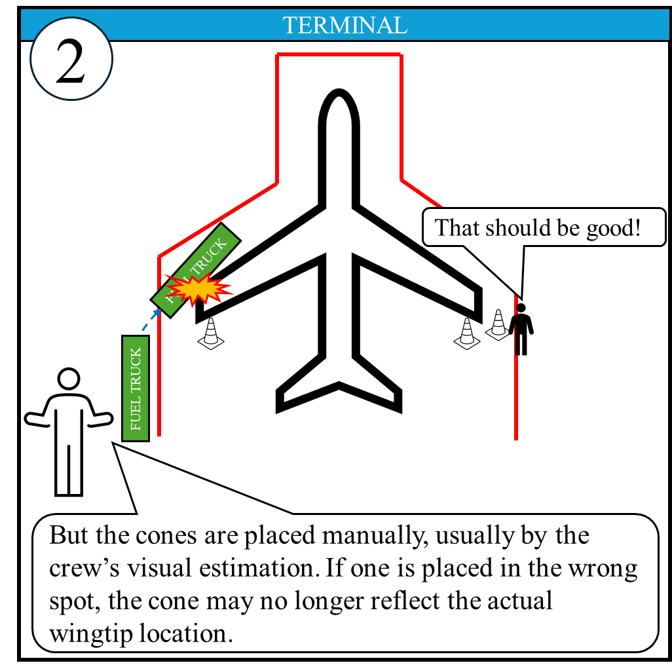
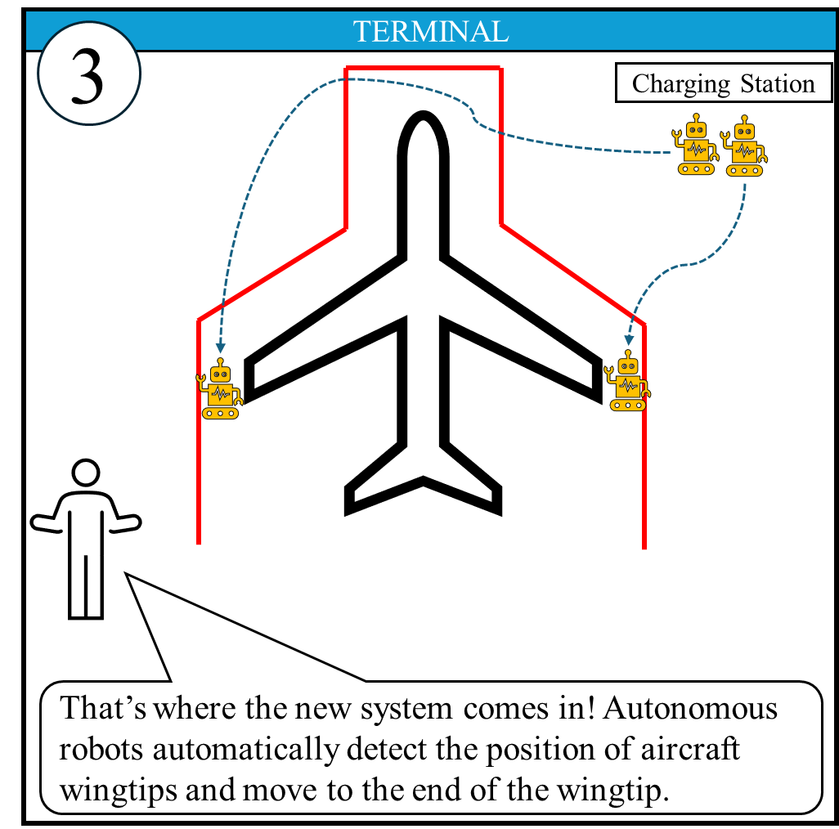
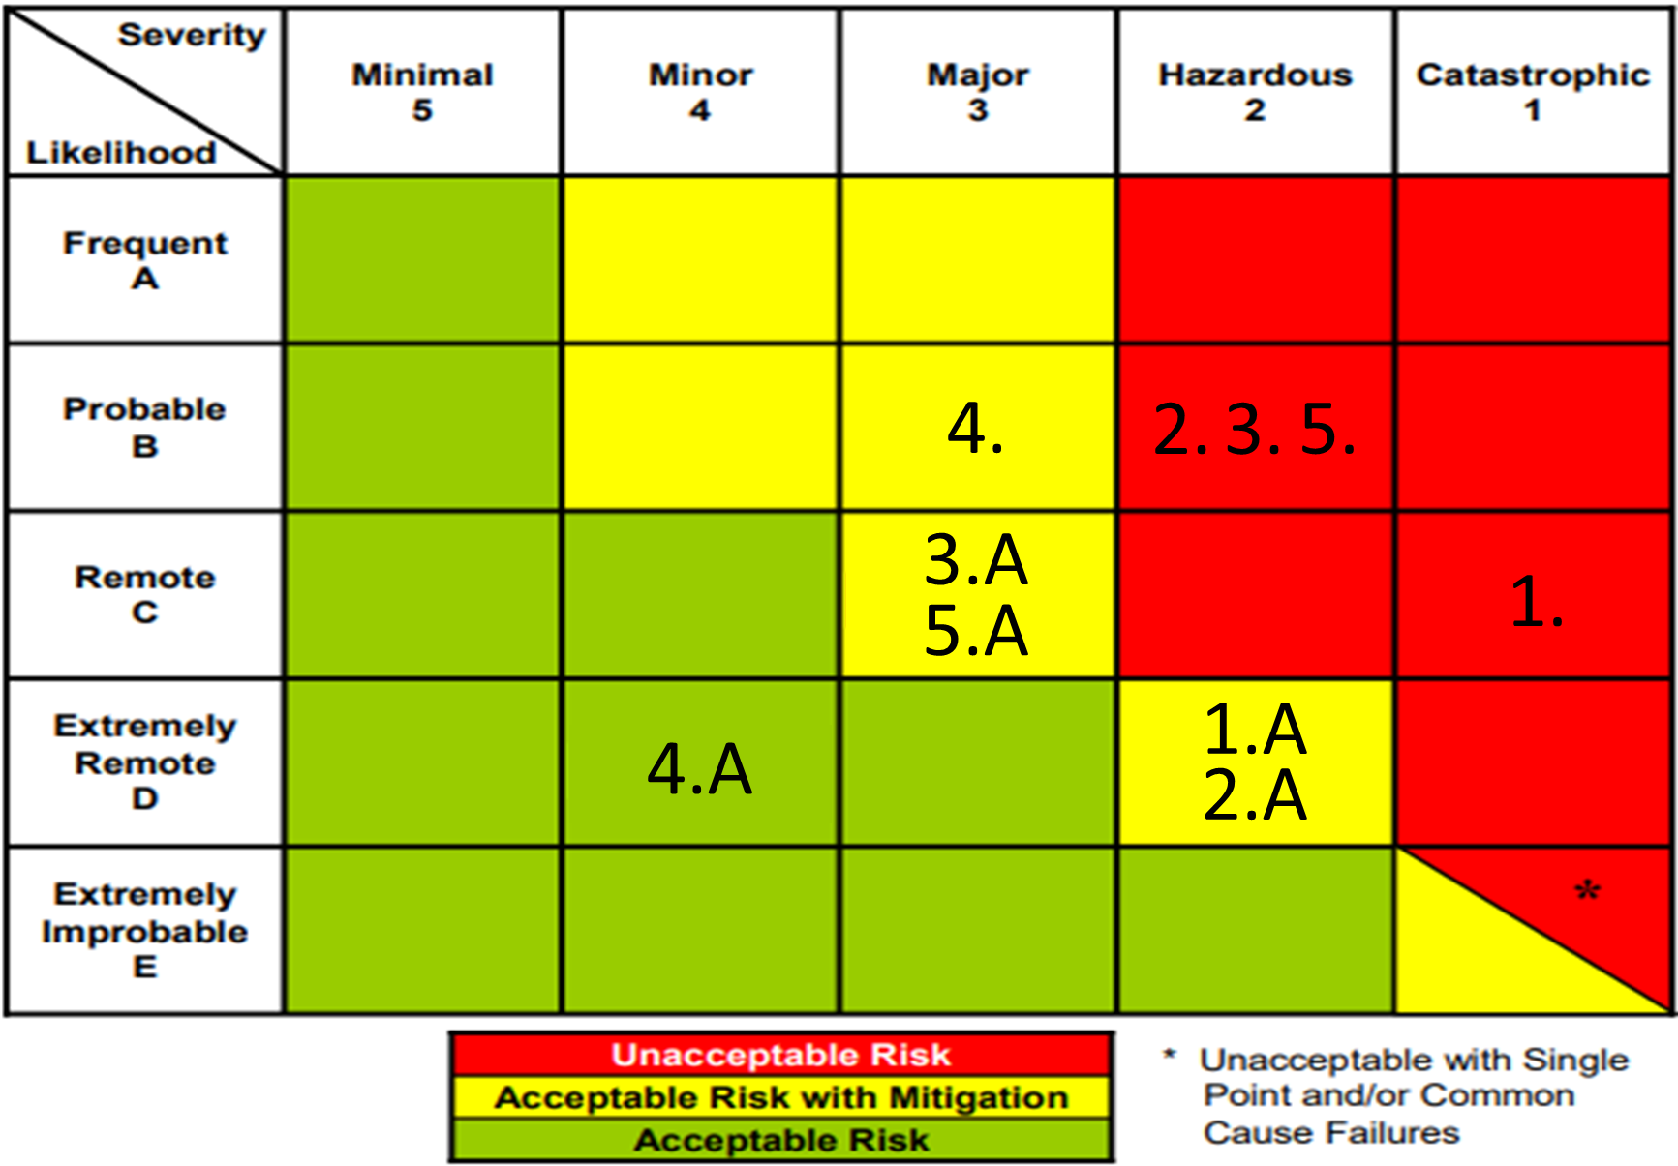
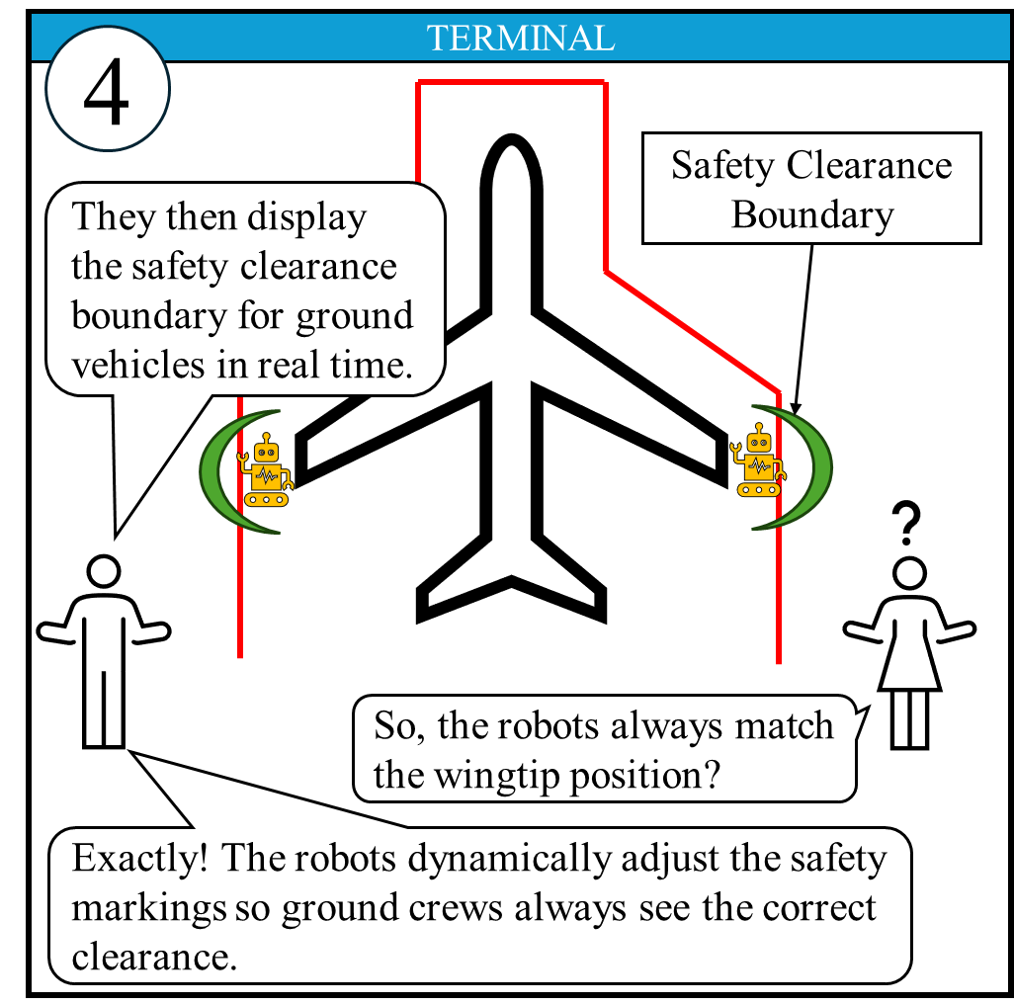
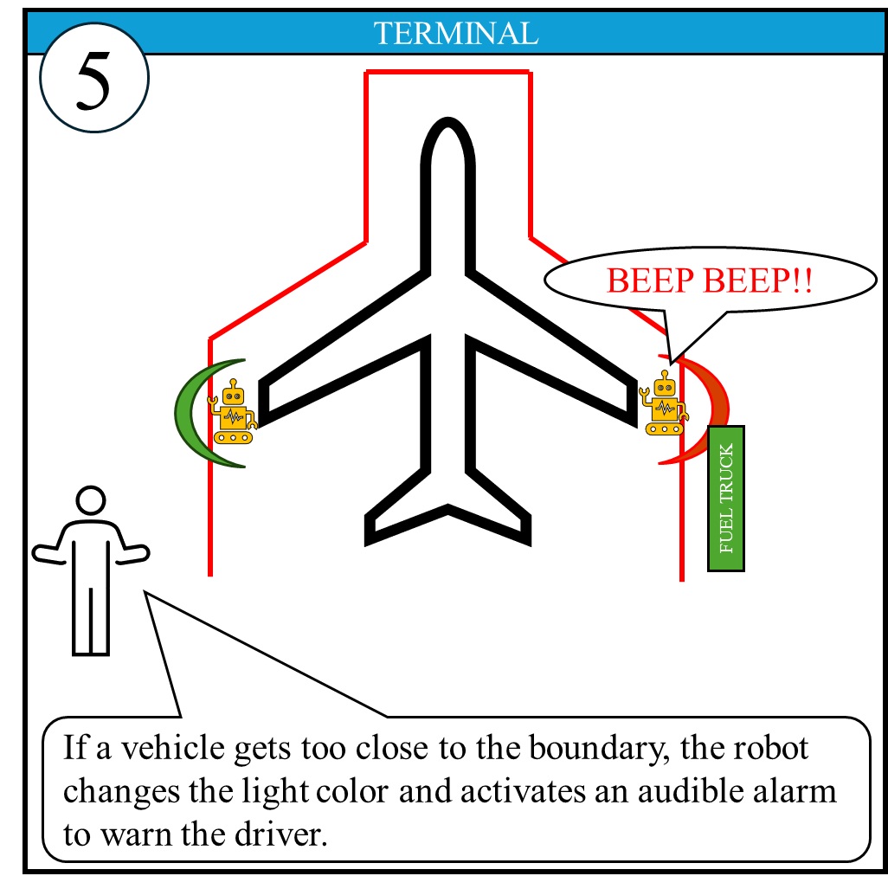
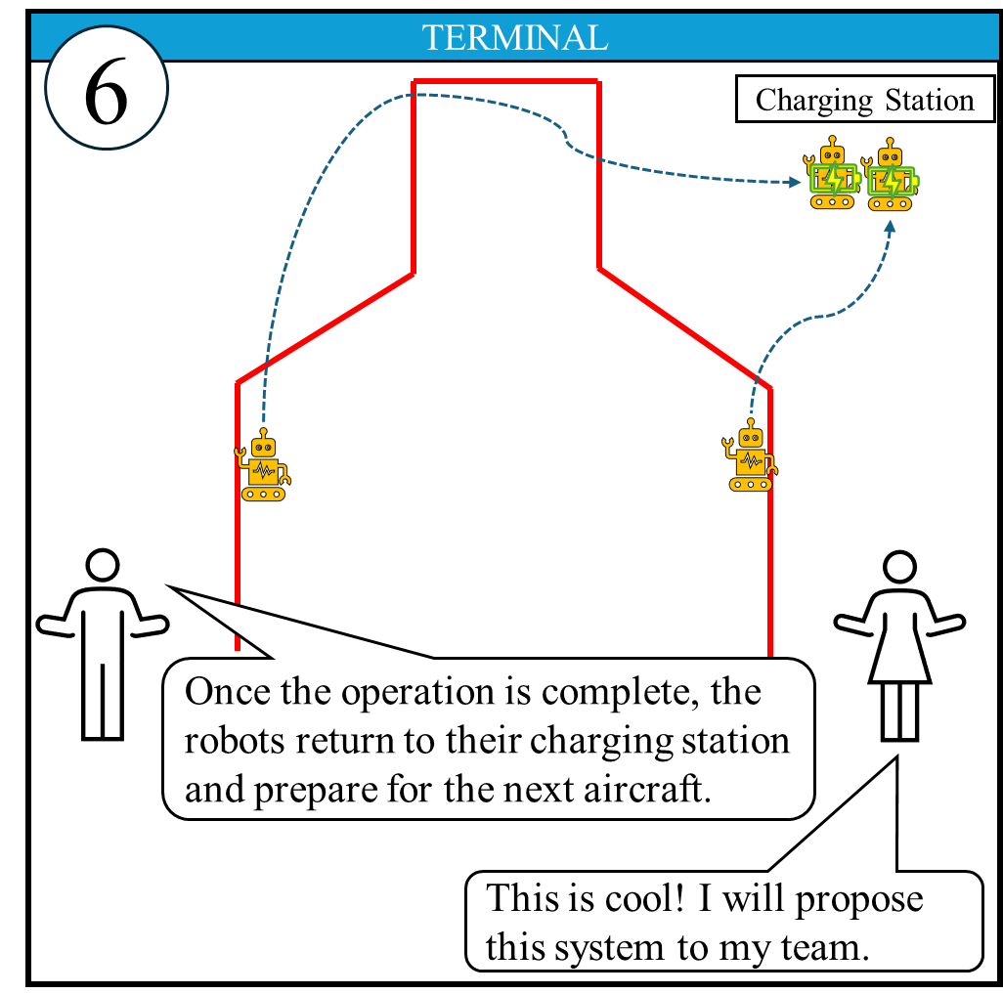
Autonomous Wingtip-Detection Robots for Apron Safety
Team Member Names: Thapanut (Foam) Munkong and Omololu Balogun
Faculty Advisor: Dr. Deborah S. Carstens, College of Aeronautics, Florida Institute of Technology
Introduction
At the airport, the apron is the most congested area where aircraft movement occurs in close proximity and several servicing vehicles scurry around the aircraft. This overcrowded environment has a high potential risk to cause collision between aircraft and other aircraft, vehicles, or obstacles in the area; a single incident could lead to a chain of flight disruption and significant financial loss (Wang & Yan, 2025). Human error contributes up to 80% of ground operation incidents, with limited situational awareness and procedural deviations identified as primary causes (Muecklich et al., 2023). This proposed design introduces autonomous robots that detect and monitor aircraft wingtips from taxi-in through servicing and pushback. It establishes real-time dynamic safety boundaries to replace manual cone placement and human wingwalker from monitoring wing separation to reduce collision risks between aircraft, vehicles, or obstacles, while removing human-heavy judgment-reliant tasks from the operations.
Prototype
Safety Risk Assessment
This assessment was conducted to evaluate foreseeable risks from the new autonomous system ensuring all risks are captured at an acceptable level.
Implementation Risk | Assessing Risk | Mitigation
1. Movement area incursion | Collision risk between the robot and the active aircraft taxi. | Geofencing and predefined operational boundaries High-visibility body color and reflective stripe
2. Sensor failure to detect vehicles or obstacles | Collision risk between aircraft and undetected aircraft, GSE, or obstacles. | Multi-sensor redundancy Pre-deployment sensor self-test Real-time sensor health monitoring
3. Alert system failure | Lack of hazard awareness for pilots, marshallers, tug drivers, and other GSE operators near aircraft. | Multiple alert channels Routine system diagnostics and pre-operation checks Real-time system health monitoring with automatic fault detection
4. Reduced performance in adverse environmental conditions (e.g., Nighttime, Rain, Snow, Low-visibility, Jet blast) | Collision risk between aircraft and adjacent aircraft or vehicles due to navigation errors, missed detections. | Weather-resistant design and stabilized base Defined operational limits/shutdown thresholds Environment-specific testing before operational approval
5. Failure to follow or station at the aircraft wingtip | Collision risk between the vehicles and the aircraft wingtip from a false safety reference. | Aircraft recognition and calibrated positioning logic Defined a positioning tolerance threshold Continuous position verification
Story board
Task and Error Analysis
Task and error analysis were conducted to identify operational gaps and safety risks in the current state.
Key Operational Gaps:
Human visual estimation error
Static safety markers
No active warning system
Labor-intensive tasks
CRITICAL TASK | CURRENT STATE | IDEAL STATE
Wingtip Monitoring (Taxi-in / Pushback) | Wingwalker visually estimates clearance | Robot detects and monitors wingtip separation in real time
Safety Marker Deployment | Ground crew manually place cones | Robot autonomously deploys to wingtip location
Safety Buffer Definition | Assumed based on cone placement | Dynamically calculated and maintained by robot
Hazard Detection | Human observation | Continuous sensor-based monitoring
Warning / Communication | Limited verbal or visual cues | Real-time visual and audio alerts
Post-Operation Retrieval | Manual cone removal | Robot autonomously returns to charging station
Cost and Benefit Analysis
Total benefit of $12,786,720 reflects life, injury, and damage savings from prevented accidents.
Total cost of $4,597,350 covers R&D, production, delivery, and 10-year maintenance.
A benefit–cost ratio of 2.78 confirms benefits significantly outweigh costs.
Intangible benefits include enhanced safety culture, situational awareness, and operational confidence through consistent, real-time wingtip protection.
Conclusion
The integration of an autonomous robot system into airport ground operations improves safety, reduces human error, optimizes workflow efficiency, and enables real-time monitoring in the apron area.
References
Wang, R., & Yan, H. (2025). Risk identification and propagation in apron operations
based on directed complex networks. Alexandria Engineering Journal, 119,
647–664. https://doi.org/10.1016/j.aej.2025.01.104
Muecklich, N., Sikora, I., Paraskevas, A., & Padhra, A. (2023). The role of human
factors in aviation ground operation-related accidents/incidents: A human error analysis approach. Transportation Engineering, 13, 100184. https://doi.org/10.1016/j.treng.2023.100184
Notes:
INSTRUCTIONS
Do not use a color background
Keep all content within the gold lines and blue and crimson bars (other than title block and icons)
Do not change the size of the poster
Please keep the text readable. The only font allowed is “Calibri”. It is available on all Microsoft products . Minimum font size is 48 pts. References can be at 30 font.
The size is already set to exactly the print size. Please arrange and size all the images and text properly.
Ensure that all images are at least 300 dpi
The name of any faculty should be put in as “Dr. [First Name] [Middle Initial]. [Last Name], Dept. Of [name of department], [name of institution]
Names of any sponsors, mentors, volunteers, helpers, etc. can be put in the acknowledgements section. Put in text only. Do not put in any additional logos in the poster other than the ones already in the template.
Your Poster file should be named as follows:
SHOWCASE_SPRING2024_POSTER_CAPSTONE MAJOR_YOURTEAMNAME*
(Example: SHOWCASE_SPRING2024_POSTER_ME_SUNNUCLEAR)
Note: The project name should be exactly as the registered project name.
*If this is an individual project, please place the title of your project instead of the team name

